Slide 1
Unified Database with Filterable
Dashboard
Team Members:
Javier Velasco
Mohamed Eltanani
Suraj Shetty
Sonia Alcantara Tuscano
Kristen Locke

Slide 2
Overview
Main objective is to clean the data and make one database without losing any data.
Extract the data from various databases.
To build a dashboard that will filter employee information and allow the user to manage how it is displayed.

Slide 3
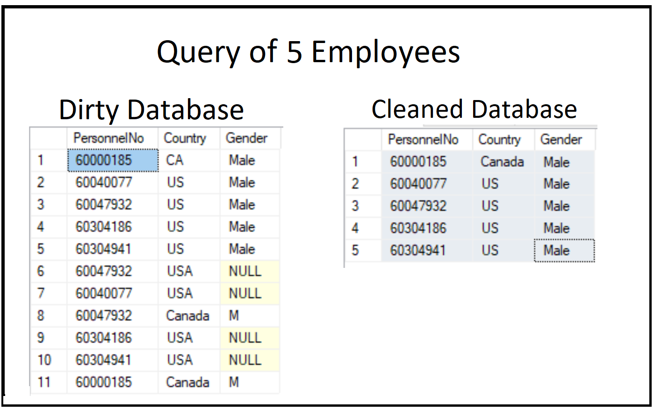

Slide 4
Build Functionality
Unified and Cleaned Databases
Created Dashboard
Created Filter options for the Dashboard

Slide 5
How it works?
The user selects filter options and based on selected filter, result will display on dashboard.
Results can be viewed in various formats.

Slide 6
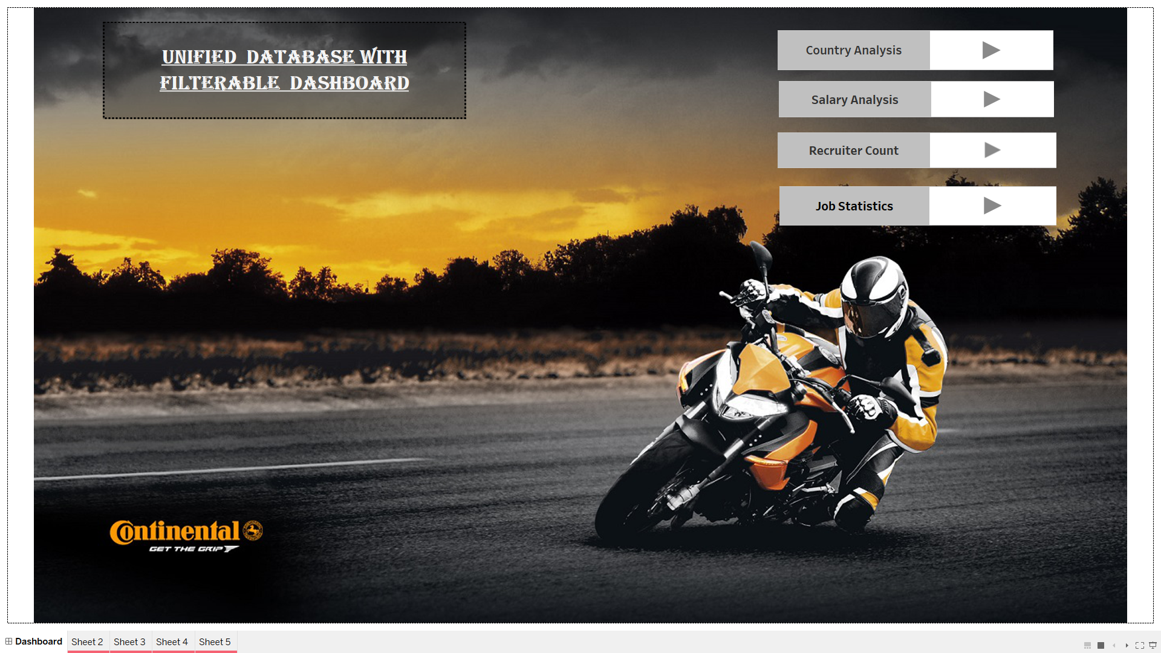

Slide 7
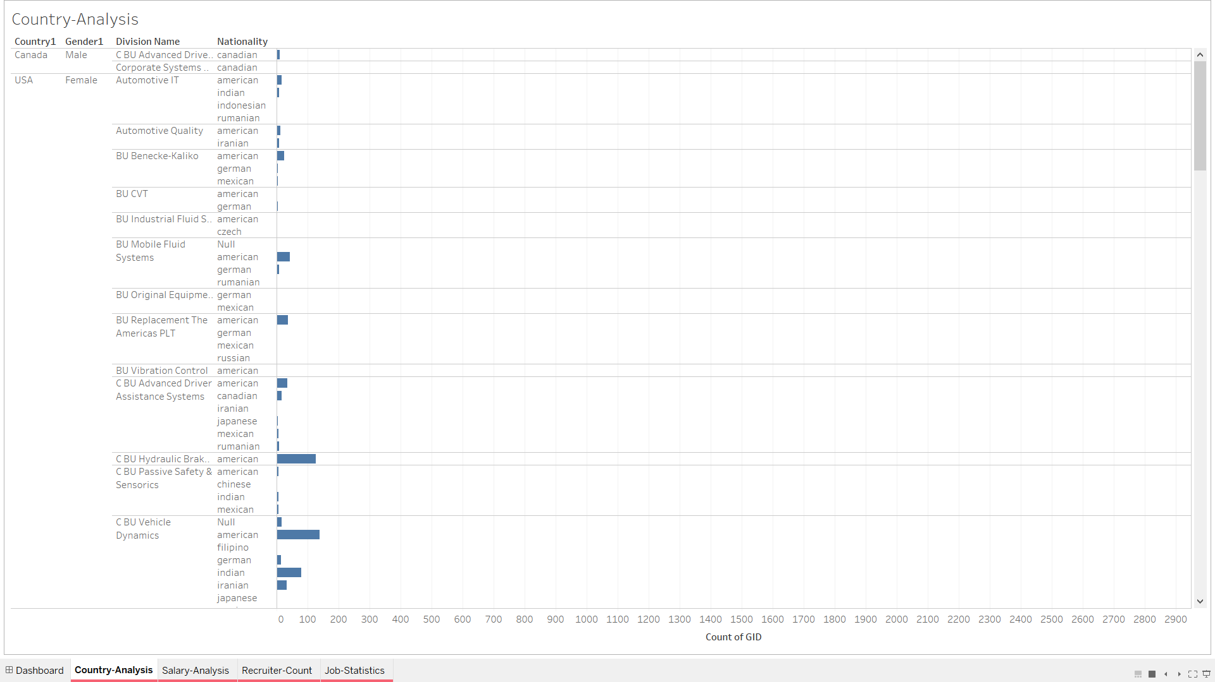

Slide 8
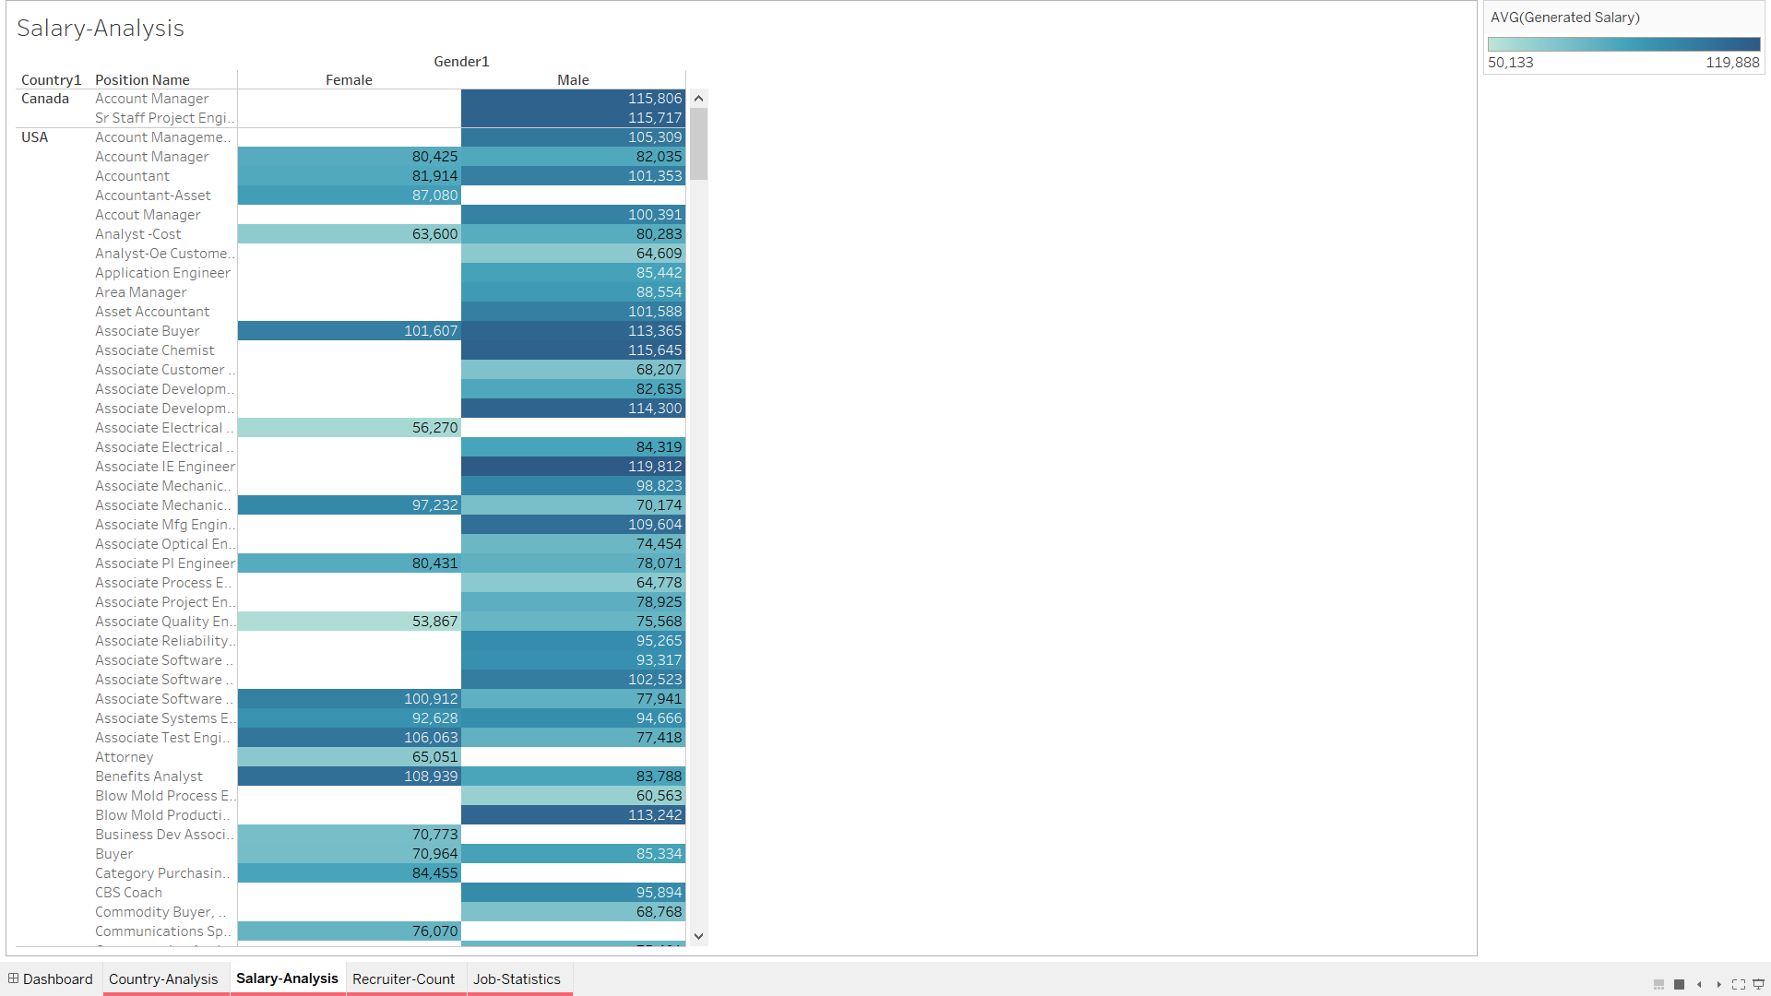

Slide 9
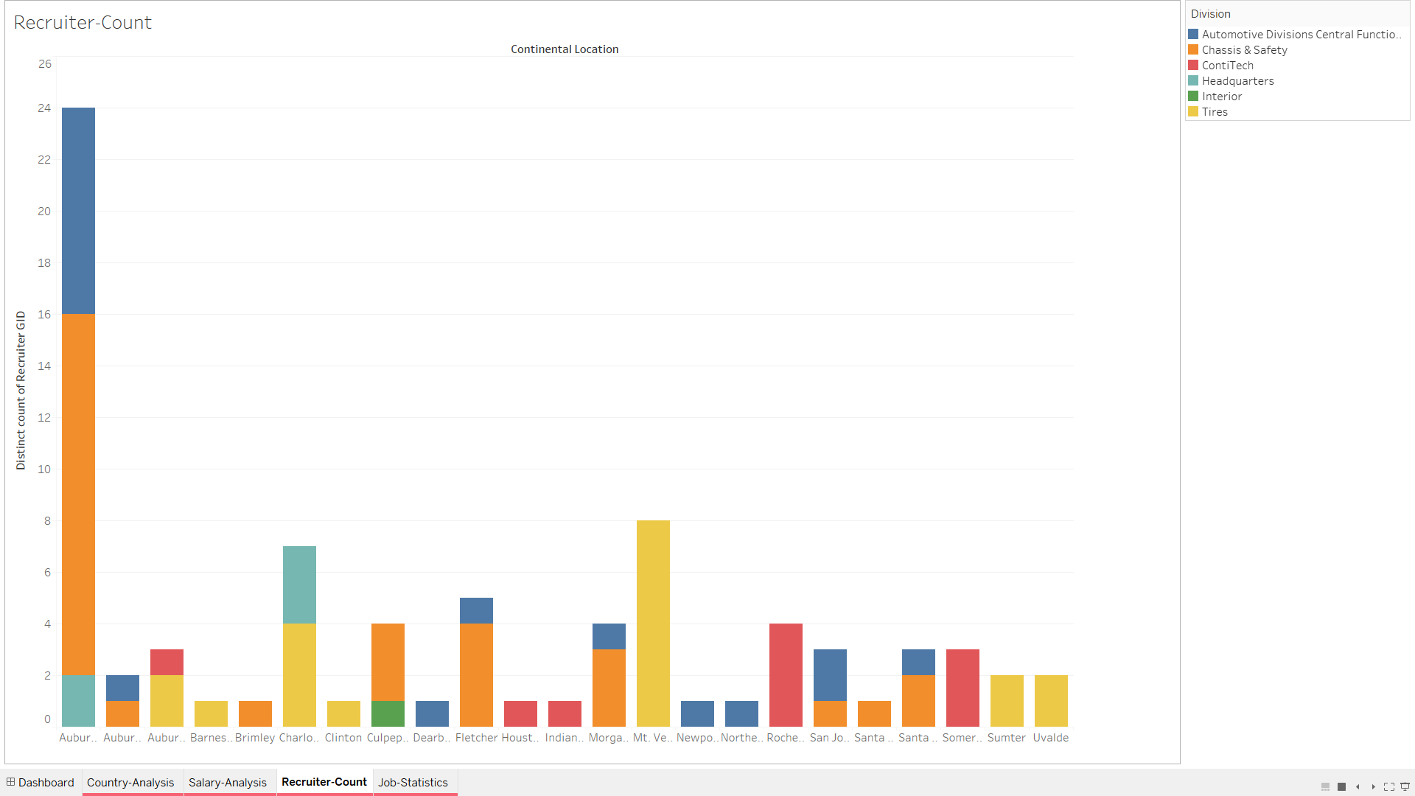

Slide 10
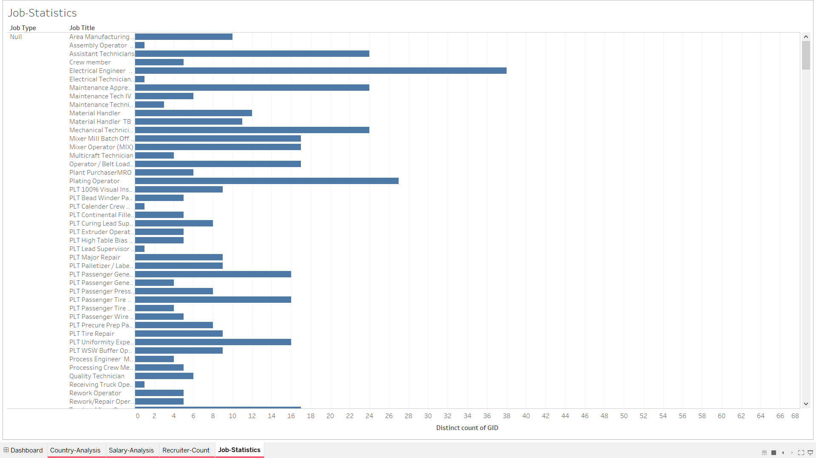

Slide 11
Future Endeavors
Login Functionality for User
Generate Reports

